Slide 1

YOUTUBE HAND GESTURE CONTROL SYSTEM
GROUP NO - 6
NAME OF TEAM MEMBERS
MUHAMMED RISHAN M R
SGI21CS015
STEVE SANTHOSH
SGI21CS020
SUMAYYA P A
SGI21CS021
SEMESTER : 6
BATCH : 2021-2025
DEPARTMENT OF CSE
SNGIST GROUP OF INSTITUTIONS
N.PARAVUR, ERNAKULAM, PIN:- 683515
21-02-2024 Project Review Presentation

Slide 2
CONTENTS
1. INTRODUCTION
2. LITERATURE REVIEW
2.1. GestureWorks
2.2. VLC Media Player with libHandWave
2.3. Kinect for Windows SDK
3. PROPOSED MODEL
4. REQUIREMENTS AND TECHNOLOGY USED
5. CONCLUSION
21-02-2024 Project Review Presentation

Slide 3
1. INTRODUCTION
The Hand Gesture Recognition and Control System pioneers natural, non-verbal communication between humans and computers, utilizing computer vision and machine learning to enable seamless interaction through hand gestures.
The Gesture Control for YouTube project introduces hands-free control of YouTube videos through innovative computer vision techniques, enabling intuitive interaction with playback using hand gestures.
By tracking and interpreting hand movements in real-time, the application recognizes specific gestures such as adjusting volume, playing/pausing videos, entering/exiting fullscreen mode, and skipping forward/rewinding, enhancing user control over YouTube content.
21-02-2024 Project Review Presentation

Slide 4

2. LITERATURE REVIEW
2.1 GestureWorks
GestureWorks is a software platform that allows developers to create gesture-based interactions for various applications, including media players. It provides tools and libraries to integrate hand gesture recognition and control into custom software solutions.
Advantages
Customizable Gestures: Tailored gestures enhance user experience.
Cross-Platform Compatibility: Supports multiple operating systems for wider accessibility.
Documentation and Support: Extensive resources aid integration and troubleshooting.
Scalability: Adaptable to projects of various sizes.
21-02-2024 Project Review Presentation

Slide 5
2. LITERATURE REVIEW
Disadvantages
Learning Curve: Steep for developers unfamiliar with gesture tech.
Cost: Licensing fees may pose a barrier, especially for smaller projects.
Hardware Dependency: Specific hardware requirements limit compatibility.
Performance Optimization: Challenges exist in optimizing for responsiveness and efficiency.
21-02-2024 Project Review Presentation

Slide 6
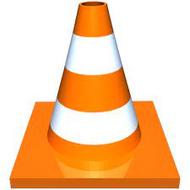
2. LITERATURE REVIEW
2.2 VLC Media Player with libHandWave
VLC media player, a popular open-source media player, has experimented with integrating gesture control using libraries like libHandWave. This allows users to control media playback through hand gestures, though it may require some technical setup and customization.
Advantages
Gesture Control: Enhances user experience by allowing intuitive media playback control.
Customization: Users can personalize gestures and mappings to suit their preferences.
Open-Source: Promotes community collaboration and innovation.
Accessibility: Provides an accessible control option for users with physical limitations.
21-02-2024 Project Review Presentation

Slide 7
2. LITERATURE REVIEW
Disadvantages
Technical Setup: Requires technical expertise for setup and configuration.
Compatibility Issues: May encounter compatibility problems with certain hardware or OS.
Limited Gestures: Gesture range and recognition may be restricted.
Reliability: Performance inconsistencies and glitches may occur.
21-02-2024 Project Review Presentation

Slide 8

2. LITERATURE REVIEW
2.3 Kinect for Windows SDK
The Kinect for Windows SDK includes features for recognizing and tracking hand gestures using the Kinect sensor. Developers can utilize this SDK to create applications, including media players, that respond to hand gestures for control.
Advantages
Depth Sensing: Enables accurate tracking of three-dimensional hand gestures.
Wide Gesture Range: Supports various gestures like waving, pointing, and swiping.
Integration: Easily integrates with existing platforms like Windows applications and Unity.
Accessibility: Facilitates interaction without physical contact, enhancing accessibility
21-02-2024 Project Review Presentation

Slide 9
2. LITERATURE REVIEW
Disadvantages
Hardware Dependency: Requires specific Kinect sensor hardware.
Processing Requirements: Demands significant processing power for real-time tracking.
Learning Curve: Presents challenges for developers new to depth-sensing technology.
Cost: Kinect hardware acquisition may be costly, affecting project feasibility.
21-02-2024 Project Review Presentation

Slide 10
3. PROPOSED MODEL
Enable users to manage playback, adjust volume, and perform various video actions seamlessly using intuitive hand gestures.
Uses computer vision to track and interpret hand movements in real-time.
Eliminates the need for traditional input devices and allow users to execute commands effortlessly.
Utilizes machine learning to enhance user convenience and accessibility.
Offer a more natural and hands-free way to interact with YouTube content and enriches the overall viewing experience for viewers.
21-02-2024 Project Review Presentation

Slide 11
3. PROPOSED MODEL
Models
The Gesture Recognizer uses a model bundle with a pre-packaged model bundle: the hand landmark model bundle. The landmark model detects the presence of hands and hand geometry.
Hand landmark model bundle
The hand landmark model bundle detects 21 key-point coordinates representing hand knuckles. It was trained on approximately 30K real-world images and synthetic hand models imposed on various backgrounds. This bundle includes a palm detection model, which identifies hand regions in an input image, and a hand landmarks detection model, which finds key-point coordinates within those regions. To optimize processing time, in Video or Live stream mode, the Gesture Recognizer utilizes bounding boxes defined by detected hand landmarks in the current frame to localize hands in subsequent frames, reducing the need to trigger the palm detection model unless necessary due to hand landmark model limitations or tracking failure.
21-02-2024 Project Review Presentation

Slide 12
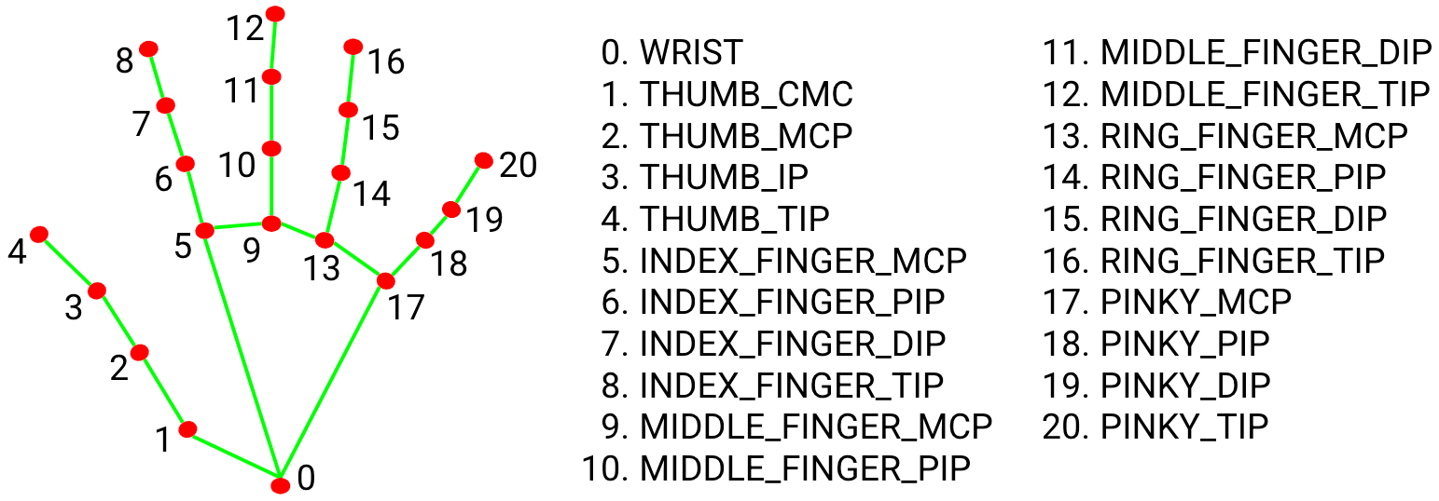
3. PROPOSED MODEL
The dataset used in this case is a file containing a few hundred or thousand images of hand gestures all labeled or sorted into subfiles of what gesture they should represent
21-02-2024 Project Review Presentation

Slide 13
3.1 ADVANTAGES OF PROPOSED MODEL
Accesibility: This project offers an accessible way for individuals with disabilities or limited mobility.
Engagement: Users can experience a more engaging and interactive experience on YouTube.
Real-Time Feedback: The project gives real time feedback and outputs based on it.
Customizable Gestures: Gives user the ability to customize gestures.
Educational and Training Applications: Explore applications beyond YouTube.
21-02-2024 Project Review Presentation

Slide 14
4. REQUIREMENTS AND TECHNOLOGY USED
Hardware Requirements
Webcam
Computer
Display Screen
Software Requirements
Python
Libraries and Modules:
cvzone
mediapipe
opencv-python
tensorflow
pyautogui
Machine Learning Model
Development Environment (IDE’s)
Gesture Training Data
21-02-2024 Project Review Presentation

Slide 15
5. SAMPLE PROGRAM
import cv2
from cvzone.HandTrackingModule import HandDetector
from cvzone.ClassificationModule import Classifier
import numpy as np
import math
import time
import pyautogui
cap = cv2.VideoCapture(0)
detector = HandDetector(maxHands=1)
classifier = Classifier('D:/Mini Project/YoutubeControl/Model/keras_model.h5', 'D:/Mini Project/YoutubeControl/Model/labels.txt')
offset = 20
imgSize = 300
counter = 0
labels = ["free_hand","right","left", "v_up","v_down","max","min","stop"]
control_delay = 5 # Delay in seconds before performing another control action
last_action_time = time.time() - control_delay
while True:
success, img = cap.read()
imgOutput = img.copy()
hands, img = detector.findHands(img)
21-02-2024 Project Review Presentation

Slide 16
5. SAMPLE PROGRAM
if hands:
hand = hands[0]
x, y, w, h = hand['bbox']
imgWhite = np.ones((imgSize, imgSize, 3), np.uint8) * 255
imgCrop = img[y - offset: y + h + offset, x - offset: x + w + offset]
if imgCrop.size == 0:
print("Empty image crop. Skipping frame.")
continue
aspectRatio = h / w
if aspectRatio > 1:
k = imgSize / h
wCal = math.ceil(k * w)
imgResize = cv2.resize(imgCrop, (wCal, imgSize))
imgResizeShape = imgResize.shape
wGap = math.ceil((imgSize - wCal)
/ 2)
imgWhite[:, wGap:wCal + wGap] = imgResize
prediction, index = classifier.getPrediction(imgWhite, draw=True)
print(prediction, ":", index)
21-02-2024 Project Review Presentation

Slide 17
5. SAMPLE PROGRAM
else:
k = imgSize / w
hCal = math.ceil(k * h)
imgResize = cv2.resize(imgCrop, (imgSize, hCal))
imgResizeShape = imgResize.shape
hGap = math.ceil((imgSize - hCal) / 2)
imgWhite[hGap:hCal + hGap, :] = imgResize
prediction, index = classifier.getPrediction(imgWhite, draw=True)
print(prediction, ":", index)
cv2.rectangle(imgOutput, (x - offset,
y - offset - 50), (x - offset + 90, y –
offset - 50 + 50), (255, 0, 255),
cv2.FILLED)
cv2.putText(imgOutput, labels[index], (x, y - 20), cv2.FONT_HERSHEY_COMPLEX, 1.7, (255, 255, 255), 2)
cv2.rectangle(imgOutput, (x - offset,
y - offset), (x + w + offset, y + h + offset)
, (255, 0, 255), 4)
cv2.imshow("ImageCrop", imgCrop)
cv2.imshow("ImageWhite", imgWhite)
# Perform YouTube controls based on
the predicted label
21-02-2024 Project Review Presentation

Slide 18
5. SAMPLE PROGRAM
current_time = time.time()
if labels[index] == "v_up" :
pyautogui.press("up") # Press up arrow key for volume up
last_action_time = current_time
elif labels[index] == "v_down":
pyautogui.press("down") # Press down arrow key for volume down
last_action_time = current_time
elif labels[index] == "free_hand":
pass # Do nothing for the "free_hand" gesture
elif labels[index] == "stop" and current_time - last_action_time >= control_delay:
pyautogui.press("space") # Press spacebar to pause/play
last_action_time = current_time
elif labels[index] == "max" and current_time - last_action_time >= control_delay:
pyautogui.press("f") # Press f
to enter full screen
last_action_time = current_time
elif labels[index] == "min" and current_time - last_action_time >= control_delay:
pyautogui.press("esc") # Press f to enter full screen
21-02-2024 Project Review Presentation

Slide 19
5. SAMPLE PROGRAM
last_action_time = current_time
elif labels[index] == "right" and current_time - last_action_time >= control_delay:
pyautogui.press("right") # Press Right Arrow to skip 5 sec
last_action_time = current_time
elif labels[index] == "left" and current_time - last_action_time >= control_delay:
pyautogui.press("left") # Press Left Arrow to revind 5 sec
last_action_time = current_time
cv2.imshow("Image", imgOutput)
key = cv2.waitKey(1)
if key == ord('q'):
break
21-02-2024 Project Review Presentation

Slide 20
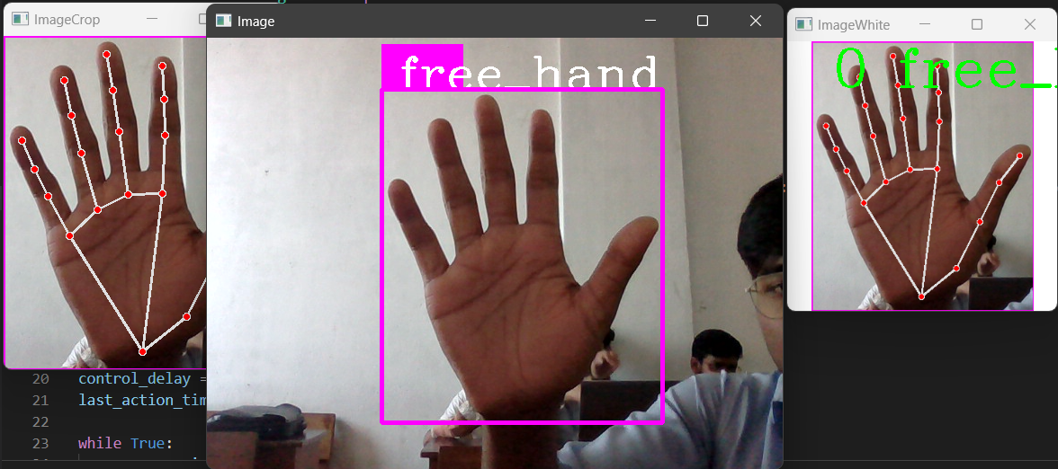
5. SAMPLE PROGRAM
21-02-2024 Project Review Presentation

Slide 21
6. CONCLUSION
In a tech-driven world, the Hand Gesture Recognition and Control System revolutionizes how we interact with technology. It harnesses computer vision and machine learning to interpret hand gestures, offering users a more intuitive way to control their computers.
While the project marks a significant advancement, it's just the beginning. Future developments aim to expand gesture recognition, enhance accuracy, and improve compatibility with various software applications, promising even smoother interactions.
This system showcases technology adapting to human behavior, paving the way for more natural and efficient digital interactions. It signals a future where complex tasks can be effortlessly accomplished with simple hand gestures.
21-02-2024 Project Review Presentation

Slide 22
T . H . A . N . K . Y . O . U
21-02-2024 Project Review Presentation

